Slide 1
CS310 Operating Systems Lecture 31: Deadlock Prevention
Ravi Mittal
IIT Goa

Slide 2
Acknowledgements !
Contents of this class presentation has been taken from various sources. Thanks are due to the original content creators:
CS162, Operating System and Systems Programming, University of California, Berkeley
Book: Modern Operating System, Andrew Tanenbaum and Herbert Bos – Chapter 6
Book: Operating Systems: Principles and Practice: Thomas Anderson and Michael Dahlin, Volume II
Chapter 5.6

Slide 3
Reading
Book: Operating Systems: Principles and Practice: Thomas Anderson and Michael Dahlin, Volume II
Book: Operating System Concepts, 10th Edition, by Silberschatz, Galvin, and Gagne
Book: Modern Operating System, Andrew Tanenbaum and Herbert Bos – Chapter 6

Slide 4
Previous Classes

Slide 5
Necessary Conditions for Deadlock
There are 4 necessary conditions for deadlock to occur
If you can prevent any one of these conditions, you can eliminate the possibility of deadlock
Bounded Resources (or Mutual Exclusion)
There are a finite number of threads that can simultaneously use a resource. Only one thread at a time can use a resource
No preemption
Once a thread acquires a resource, its ownership cannot be revoked until the thread acts to release it
Wait while Holding
A thread holds one resource while waiting for another
Also called multiple independent requests
Circular Waiting
A set of waiting threads such that each thread is waiting for a resource held by another
Book: OS : Anderson and Dahlin

Slide 6
Resource-Allocation Graph (RAG) Examples
R₁
R₂
R₁
R₂
Model: Directed Graph
request edge
T_{i} → R_{j}
assignment edge
R_{j} → T_{i}
R₁
T₂
T₁
T₂
T₃
T₁
T₂
T₃
T₁
T₃
R₃
R₃
T₄
R₄
R₂
R₄
Simple Resource
Allocation Graph
Allocation Graph With Deadlock
Allocation Graph With Cycle, but
No Deadlock
Instead of thread T, we can also represent a process with a circle

Slide 7
Banker’s Algorithm
Suppose we know the worst case resource needs of processes in advance
A bit like knowing the credit limit on your credit cards. (This is why they call it the Banker’s Algorithm)
Observation: Suppose we just give some process ALL the resources it could need…
Then it will execute to completion.
After which it will give back the resources.
Like a bank: If Visa just hands you all the money your credit lines permit, at the end of the month, you’ll pay your entire bill

Slide 8
Banker’s Algorithm
So…
A process pre-declares its worst-case needs
Then it asks for what it “really” needs, a little at a time
The algorithm decides when to grant requests
It delays a request unless:
It can find a sequence of processes…
such that it could grant their outstanding need…
so they would terminate…
letting it collect their resources…
and in this way it can execute everything to completion!

Slide 9
Today we will study
Deadlock Prevention Approaches
Deadlock Recovery Approaches

Slide 10
How Should a System Deal With Deadlock?
Three different approaches:
Deadlock avoidance
Deadlock prevention
Deadlock recovery
Kumar CS 162 at UC Berkeley, Summer 2020

Slide 11
Deadlock Prevention

Slide 12
Issues with Deadlock Avoidance
Deadlock avoidance is very hard
It requires information about future resource requests
Future Resource requests are not easily known
Then, how to prevent deadlocks?
Relook at 4 conditions that can cause deadlock

Slide 13
Conditions for Deadlock
If you can prevent any one of these conditions, you can eliminate the possibility of deadlock
Mutual Exclusion (Bounded Resources)
Only one thread at a time can use a resource. Only one thread at a time can use a resource
No preemption
Once a thread acquires a resource, its ownership cannot be revoked until the thread acts to release it
Wait while Holding
A thread holds one resource while waiting for another
Also called multiple independent requests
Circular Waiting
A set of waiting threads such that each thread is waiting for a resource held by another
Book: OS : Anderson and Dahlin

Slide 14
Attack Mutual Exclusion Condition

Slide 15
Deadlock Prevention (remove Mutual Exclusion)
Remove “Mutual Exclusion”
Infinite resources
Example: Virtual Memory

Slide 16
(Virtually) Infinite Resources
Thread A
AllocateOrWait(1 MB)
AllocateOrWait(1 MB)
Free(1 MB)
Free(1 MB)
Thread B
AllocateOrWait(1 MB)
AllocateOrWait(1 MB)
Free(1 MB)
Free(1 MB)
With virtual memory we have infinite space so everything will just succeed.

Slide 17
Attack Mutual Exclusion – Example
Don’t assign a resource exclusively to a single process
How about writing to a printer?
Printer is dedicated to a process at a time
Solution: Use printer spooler
Now, several processes can generate output at a time
The only process that actually requests the physical printer is the printer daemon
Daemons are programmed to to print only after the complete file is available

Slide 18
Attack Mutual Exclusion – Example
However, NOT all devices can be spooled
Principle:
Avoid assigning a resource unless it is absolutely necessary and try to make sure that as few processes as possible may actually claim the processor

Slide 19
Attack Hold and Wait Condition

Slide 20
Attacking the Hold and Wait Condition
Require all processes request resources before starting
If everything is available, the process will be allocated whatever it needs and can run to completion
Problem with the above approach:
Many processes don’t know how many resources they need until they start running
Resources are not used optimally – resources get tied up until process completes (may take hours)
Another Solution: back-off and retry
A process requesting a resource to first temporarily release all the resources it currently holds
Then it tries to get everything it needs all at once

Slide 21
Request Resource Atomically
Thread A
x.Acquire();
y.Acquire();
…
y.Release();
x.Release();
Thread B
y.Acquire();
x.Acquire();
…
x.Release();
y.Release();
Or consider this:
Thread A
z.Acquire();
x.Acquire();
y.Acquire();
z.Release();
…
y.Release();
x.Release();
Thread B
z.Acquire();
y.Acquire();
x.Acquire();
z.Release();
…
x.Release();
y.Release();
Consider instead:
Thread A
Acquire_both(x, y);
…
y.Release();
x.Release();
Thread B
Acquire_both(y, x);
…
x.Release();
y.Release();

Slide 22
Attacking – No preemption Condition

Slide 23
Attacking the No Preemption Condition
This is not a viable option
Consider a process given the printer
halfway through its job
now forcibly take away printer
!!??

Slide 24
Attacking – Circular Wait Condition

Slide 25
Attacking Circular Wait Condition
There are several ways to eliminate circular wait
Process is entitled to a single resource at any moment
If it needs the second one, it has to release the first one
→ Not possible in many use cases – eg copy a huge file from a tape to a printer
Provide a global numbering of all resources
Rule:
Processes can request resources whenever they want to
All requests must be made in numerical order
Example: A process may request first a printer and then a tape drive, but it may not request first a plotter and then a printer (see diagram in the next slide)

Slide 26
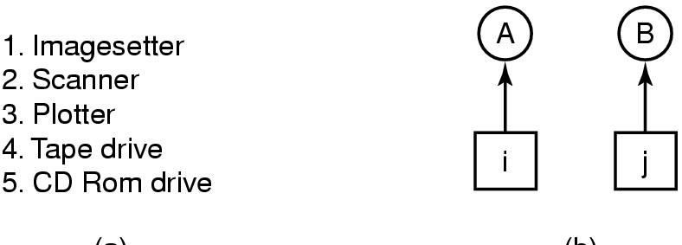
Attacking the Circular Wait Condition
Resource allocation graph will never have cycles
Two processes A and B
Deadlock can happen when when A requests j and B requests I
If i < j, B is not allowed to request I, and vice versa
Many variations to this approach exist

Slide 27
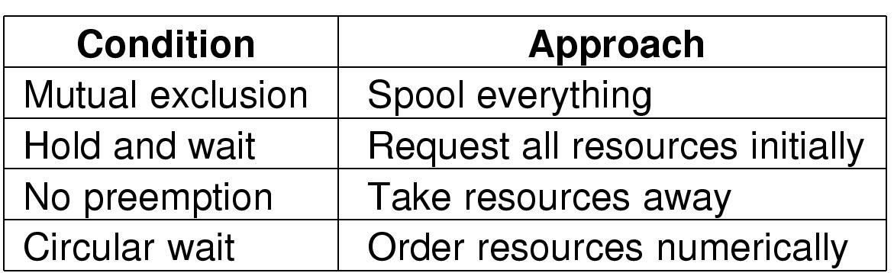
Summary of all deadlock prevention approaches

Slide 28
Deadlock Recovery

Slide 29
How Should a System Deal With Deadlock?
Three different approaches:
Deadlock avoidance
Deadlock prevention
Deadlock recovery
Kumar CS 162 at UC Berkeley, Summer 2020

Slide 30
Deadlock Recovery
Let deadlock happen, and then figure out how to deal with it

Slide 31
How to Deal with Deadlock?
Terminate thread, force it to give up resources
Dining Philosophers Example: Remove a dining philosopher
In AllocateOrWait example, OS kills a process to free up some memory
Not always possible—killing a thread holding a lock leaves world inconsistent
Roll back actions of deadlocked threads
Common techniques in databases (transactions)
Of course, if you restart in exactly the same way, may enter deadlock again
Preempt resources without killing off thread
Temporarily take resources away from a thread
Doesn’t always fit with semantics of computation

Slide 32
Lecture Summary
Resource deadlock can be avoided by keeping track of which states are safe and which are unsafe.
Resource deadlock can be structurally prevented by building the system in such a way that it can never occur by design
Allowing processes to hold one resource at a time
Resource deadlock can also be prevented by numbering all the resources and making processes request them in strictly increasing order
Once deadlock happens, system must recover from it by
Killing a thread or process
Rolling back actions of deadlocked thread or process
Preempt resources without killing thread or process

